Slide 1
Software Requirements Analysis and Specification
Requirements

Slide 2
Understand and specifying requirements
A problem of scale
  For small scale: understand and specifying requirements is easy
  For large scale: very hard; probably the hardest, most problematic and error prone
The requirements task:
  Input: User needs in minds of people (hopefully)
  Output: precise statement of what the future system will do
Requirements

Slide 3
Challenges
Identifying and specifying requirements
  Necessarily involves people interaction
  Cannot be automated
Requirements

Slide 4
Background..
What is a Requirement?
  A condition or capability that must be possessed by a system (IEEE)
What is the work product of the Req. phase ?
  A software requirements specification (SRS) document
What is an SRS ?
  A complete specification of what the proposed system should do!
Requirements

Slide 5
Background..
Requirements understanding is hard
  Visualizing a future system is difficult
  Capability of the future system not clear, hence needs not clear
  Requirements change with time
  …
Essential to do a proper analysis and specification of requirements
Requirements

Slide 6
Purpose of SRS document?
SRS establishes basis of agreement between the user and the supplier.
  Users needs have to be satisfied, but user may not understand software
  Developers will develop the system, but may not know about problem domain
SRS is
  the medium to bridge the communications gap, and
  specifies user needs in a manner both can understand
Requirements

Slide 7
Need for SRS…
Helps user understand his needs.
  users do not always know their needs
  must analyze and understand the potential
  The requirement process helps clarify needs
SRS provides a reference for validation of the final product
  Clear understanding about what is expected.
  Validation - “ SW satisfies the SRS “
Requirements

Slide 8
Need for SRS…
High quality SRS essential for high Quality SW
  Requirement errors get manifested in final sw
  To satisfy the quality objective, must begin with high quality SRS
  Requirements defects cause later problems
    25% of all defects in one study; 54% of all defects found after user testing
    defects often found in previously approved SRS.
Requirements

Slide 9
Need for SRS…
Good SRS reduces the development cost
  SRS errors are expensive to fix later
  Req. changes can cost a lot (up to 40%)
  Good SRS can minimize changes and errors
  Substantial savings; extra effort spent during req. saves multiple times that effort
An Example
  Cost of fixing errors in req. , design , coding , acceptance testing and operation are 2 , 5 , 15 , 50 , 150 person-months
Requirements

Slide 10
Requirements Process
Basic activities:
  Problem or requirement analysis
  Requirement specification
  Validation
Analysis involves elicitation and is the hardest
Requirements

Slide 11
Requirement process..
needs
Process is not linear, it is iterative and parallel
Overlap between phases - some parts may be analyzed and specified
Specification itself may help analysis
Validation can show gaps that can lead to further analysis and spec
Analysis
Specification
Validation
Requirements

Slide 12
Requirements Process…
Divide and conquer is the basic strategy
  Decompose into small parts, understand each part and relation between parts
Large volumes of information is generated
  Organizing them is a key
Techniques like data flow diagrams, object diagrams etc. used in the analysis
Requirements

Slide 13
Problem Analysis
Analysis
Specification
Aim: to gain an understanding of the needs, requirements, and constraints on the software
Analysis involves
  Interviewing client and users
  Reading manuals
  Studying current systems
  Helping client/users understand new possibilities
  Like becoming a consultant
Must understand the working of the organization , client, and users
Validation
Requirements

Slide 14
Problem Analysis…
Some issues
  Obtaining the necessary information
  Brainstorming: interacting with clients to establish desired properties
  Information organization, as large amount of info. gets collected
  Ensuring completeness
  Ensuring consistency
  Avoiding internal design
Requirements

Slide 15
Problem Analysis…
Interpersonal issues are important
Communication skills are very important
Basic principle: problem partition
Partition w.r.t what?
  Object - OO analysis
  Function - structural analysis
  Events in the system – event partitioning
Projection - get different views
Will discuss few different analysis techniques
Requirements

Slide 16
Informal Approach to Analysis
No defined methodology; info obtained through analysis, observation, interaction, discussions,…
No formal model of the system built
Obtained info organized in the SRS; SRS reviewed with clients
Relies on analyst experience and feedback from clients in reviews
Useful in many contexts
Requirements

Slide 17
Data Flow Modeling
Widely used; focuses on functions performed in the system
Views a system as a network of data transforms through which the data flows
Uses data flow diagrams (DFDs) and functional decomposition in modeling
The Structured System Analysis and Design (SSAD) methodology uses DFD to organize information, and guide analysis
Requirements

Slide 18
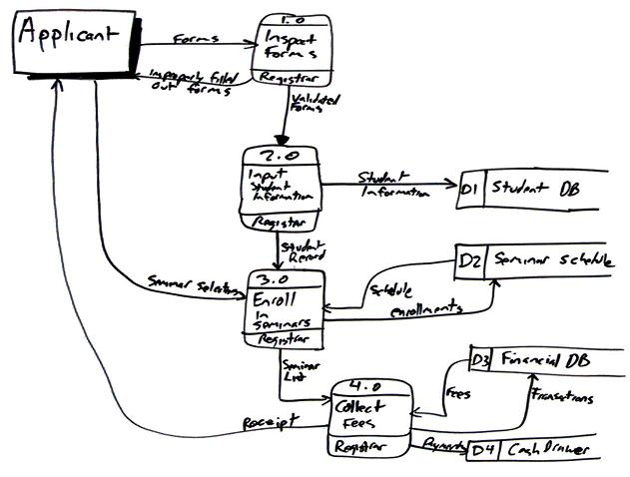
Example DFD: Enrolling in a University
Requirements
In Gane and Sarson notation

Slide 19
Data flow diagrams
A DFD shows flow of data through the system
  Views system as transforming inputs to outputs
  Transformation done through transforms
  DFD captures how transformation occurs from input to output as data moves through the transforms
  Not limited to software
Requirements

Slide 20
Data flow diagrams…
Other common DFD notation:
  A rectangle represents a source or sink and is originator/consumer of data (often outside the system)
  Transforms represented by named circles/bubbles
  Bubbles connected by arrows on which named data travels
  Data stored underlined
Moral: choose one and stick with it – can be helpful to provide a legend to make sure readers are aware of the conventions in use
Requirements

Slide 21
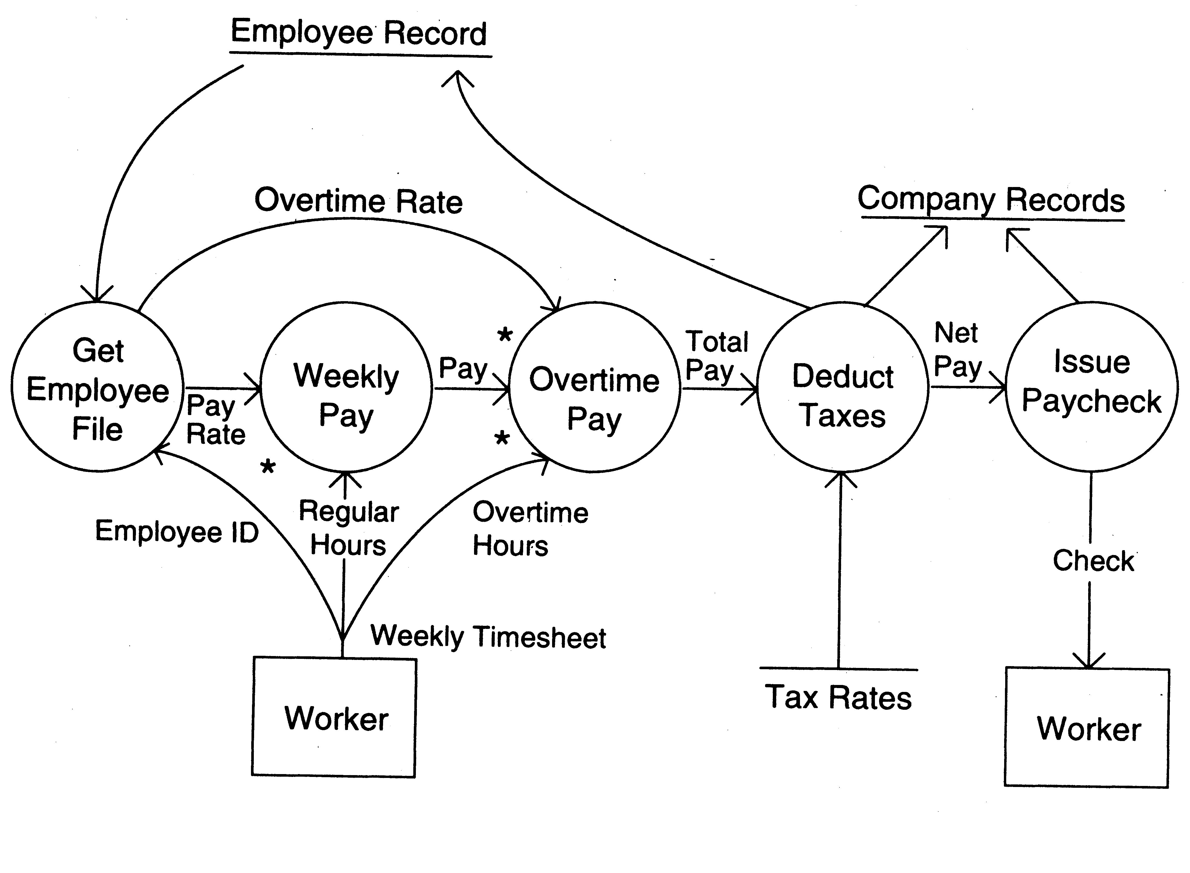
DFD Example
Requirements

Slide 22
DFD Conventions
External files shown as labeled straight lines
Need for multiple data flows by a process represented by * (means and)
OR relationship represented by +
All processes and arrows should be named
Processes should represent transforms, arrows should represent some data
Requirements

Slide 23
Data flow diagrams…
Focus on what transforms happen, how they are done is not important
Usually major inputs/outputs shown, minor are ignored in this modeling
No loops , conditional thinking , …
DFD is NOT a control chart, no algorithmic design/thinking
Requirements

Slide 24
The Flow Model
Every computer-based system is an
information transform ....
computer
based
system
input
output

Slide 25
Data Flow Diagrams
WHAT ARE DATA FLOW DIAGRAMS?
DFDs models the system by depicting
  External entities from which the data flows and where results terminate
  Processes which transform data flows
  Data stores from which the data are read or into which data are written by the processes.

Slide 26
Flow Modeling Notation
External Entity
Process
Data flow
Data store

Slide 27
External Entity
A producer or consumer of data
Examples: a person, a device, a sensor
Another example: computer-based system
Data must always originate somewhere and must always be sent to something

Slide 28
Process
A data transformer (changes input
to output)
Examples: compute taxes, determine area, format report, display graph
Data must always be processed in some
way to achieve system function

Slide 29
Data Flow
Data flows through a system, beginning
as input and transformed into output.
base
compute
triangle
area
area
height

Slide 30
Data Stores
Data is often stored for later use.
sensor #
sensor #, type,
location, age
look-up
sensor
data
report required
type,
location, age
sensor number
sensor data

Slide 31
DFD Rules and Tips
Each process should have at least one input and an output.
Each data store should have at least one data flow in and one data flow out.
Data stored in a system must go through a process.
All processes in a DFD go to another process or a data store.

Slide 32
DFD levels and layers:
From context diagrams to pseudocode
A data flow diagram can dive into progressively more detail by using levels and layers, zeroing in on a particular piece.
DFD levels are numbered 0, 1 or 2, and occasionally go to even Level 3 or beyond.

Slide 33
DFD 0
DFD Level 0 is also called a Context Diagram. It’s a basic overview of the whole system or process being analyzed or modeled.
It’s designed to be an at-a-glance view, showing the system as a single high-level process, with its relationship to external entities.
It should be easily understood by a wide audience, including stakeholders, business analysts, data analysts and developers.

Slide 34
DFD 0
DFD Level 0 is also called a Context Diagram. It’s a basic overview of the whole system or process being analyzed or modeled.
It’s designed to be an at-a-glance view, showing the system as a single high-level process, with its relationship to external entities.
It should be easily understood by a wide audience, including stakeholders, business analysts, data analysts and developers.

Slide 35
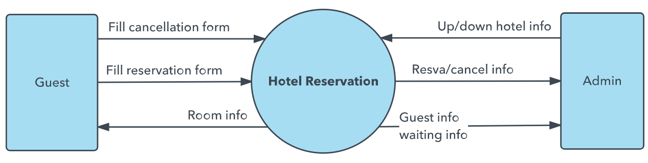
DFD 0

Slide 36
DFD-1
DFD Level 1 provides a more detailed breakout of pieces of the Context Level Diagram.
You will highlight the main functions carried out by the system, as you break down the high-level process of the Context Diagram into its sub-processes.

Slide 37
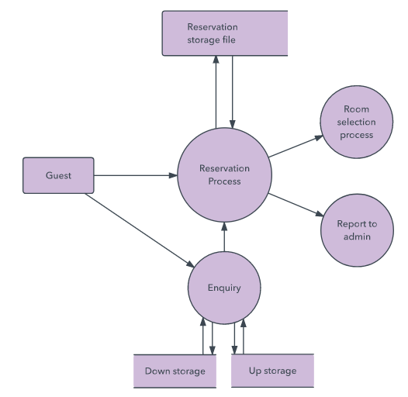
DFD-1

Slide 38
DFD-2
DFD Level 2 then goes one step deeper into parts of Level 1.
It may require more text to reach the necessary level of detail about the system’s functioning.

Slide 39
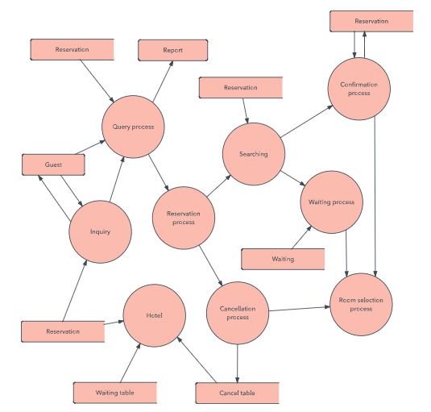
DFD-2

Slide 40
DFD 3, 4
Progression to Levels 3, 4 and beyond is possible, but going beyond Level 3 is uncommon.
Doing so can create complexity that makes it difficult to communicate, compare or model effectively.

Slide 41
Logical DFD vs. Physical DFD
A Logical DFD visualizes the data flow that is essential for a business to operate. It focuses on the business and the information needed, not on how the system works or is proposed to work.
A Physical DFD shows how the system is actually implemented now, or how it will be. For example, in a Logical DFD, the processes would be business activities, while in a Physical DFD, the processes would be programs and manual procedures.

Slide 42
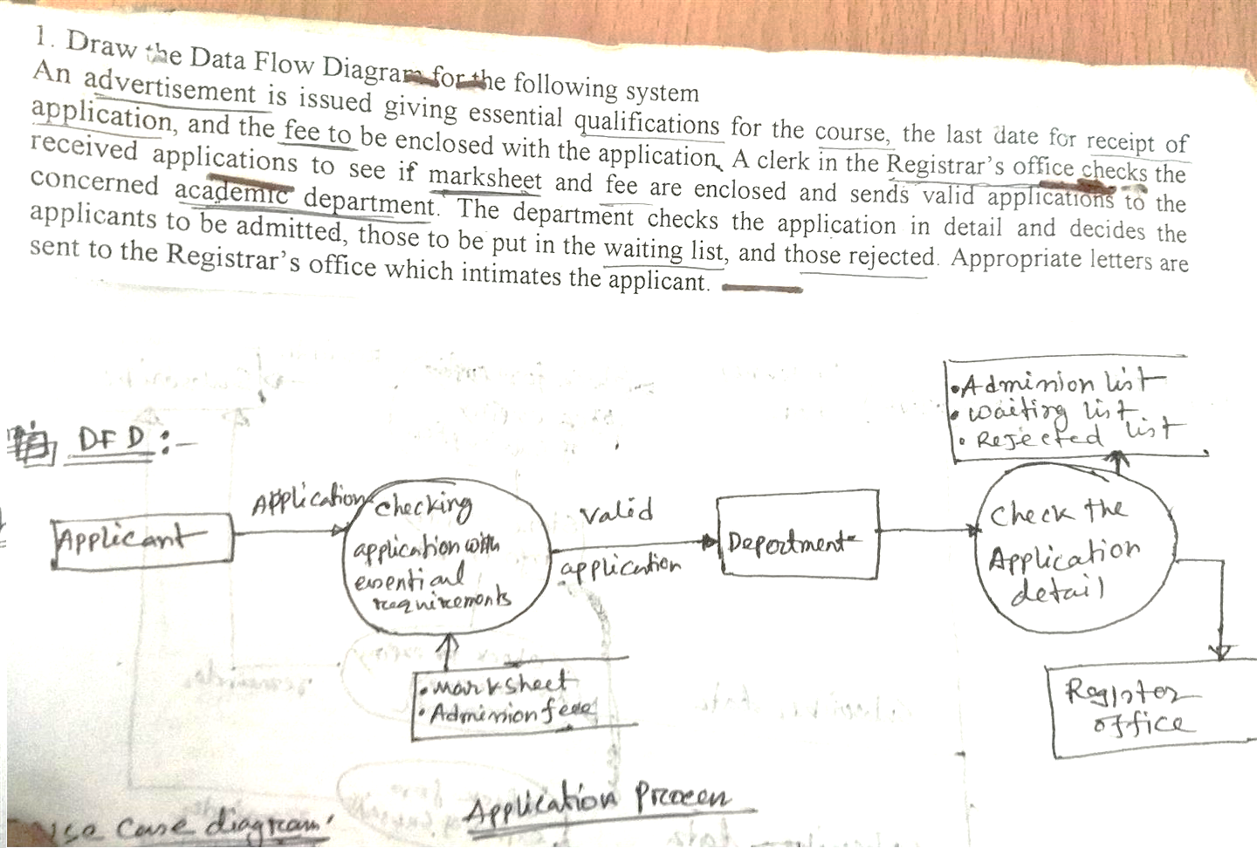
Example-1
An advertisement is issued giving essential qualifications for the course , the last date for receipt of application, and the fee to be enclosed with the application. A clerk in the Registrar’s office checks the received applications to see if marksheet and fee are enclosed and sends valid applications to the concerned academic department. The department checks the application in details and decides the applications to be admitted, those to be put in the waiting list, and those rejected. Appropriate letters are sent to the Registrar’s office which intimates the applicant.

Slide 43
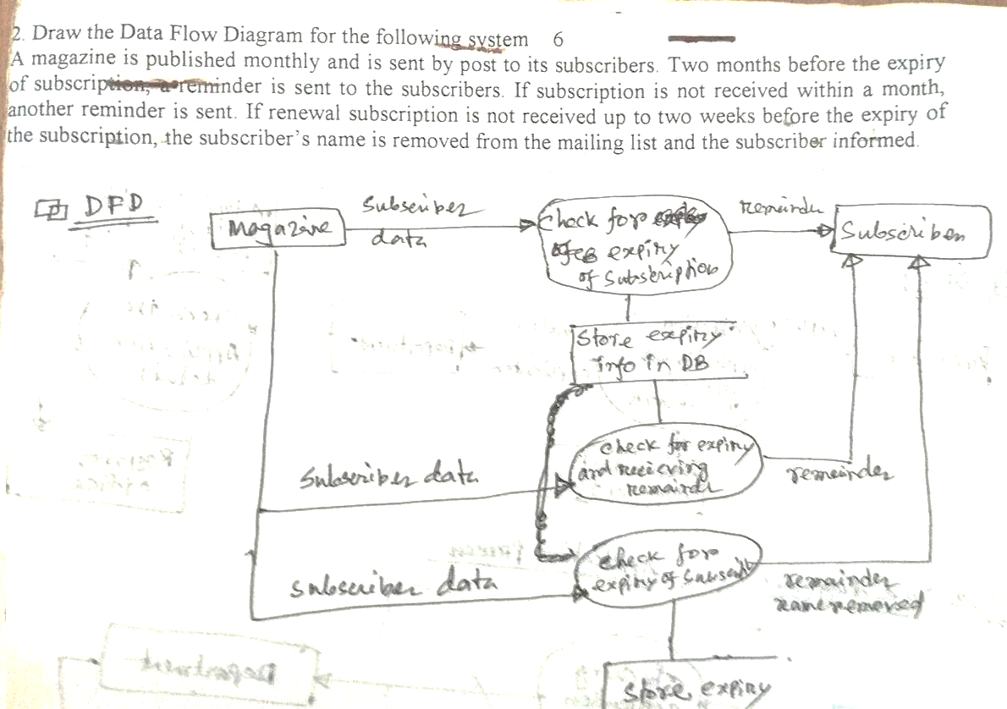
Example-2
A magazine is published monthly and is sent by post to its subscribers. Two months before the expiry of subscriptions, a reminder is sent to the subscribers. If subscription is not received within a month, another reminder is send. If renewal subscription is not received up to two weeks before the expiry of the subscriptions, the subscribers name is removed from the mailing list and the subscriber informed.

Slide 44
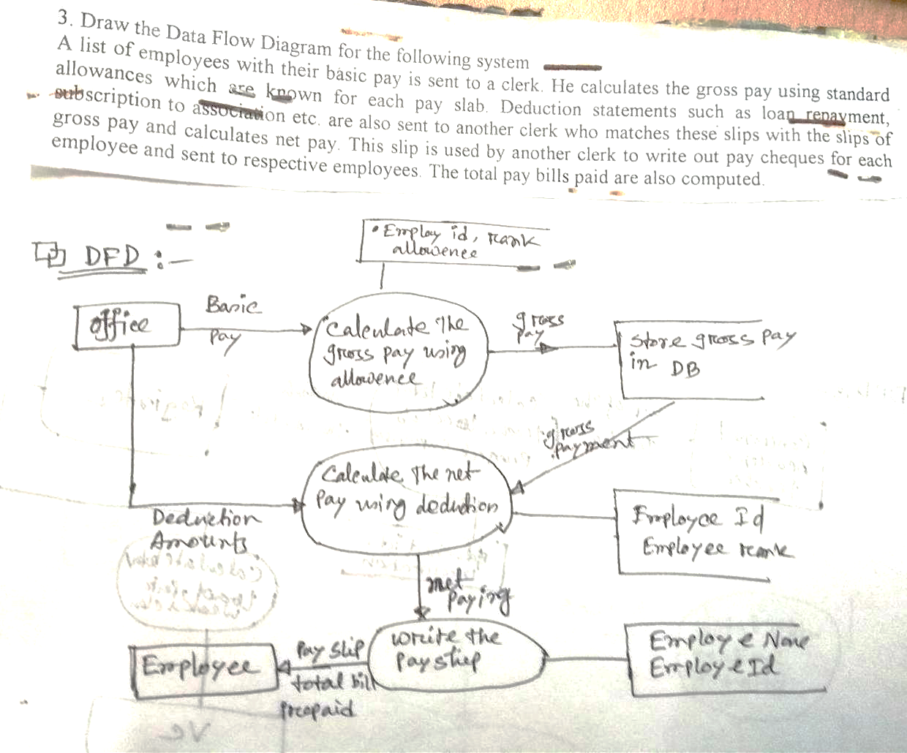
Example-3
A list of employees with their basic pay is sent to a clerk. He calculates the gross pay using standard allowances which are known for each pay slab. Deduction statements such as loan payment subscription to association etc. are also sent to another clerk who matches these slips with the slips of gross pay and calculates net pay. This slip is used by another clerk to write out pay cheques for each employee and sent to respective employees. The total pay bills paid are also computed.

Slide 45
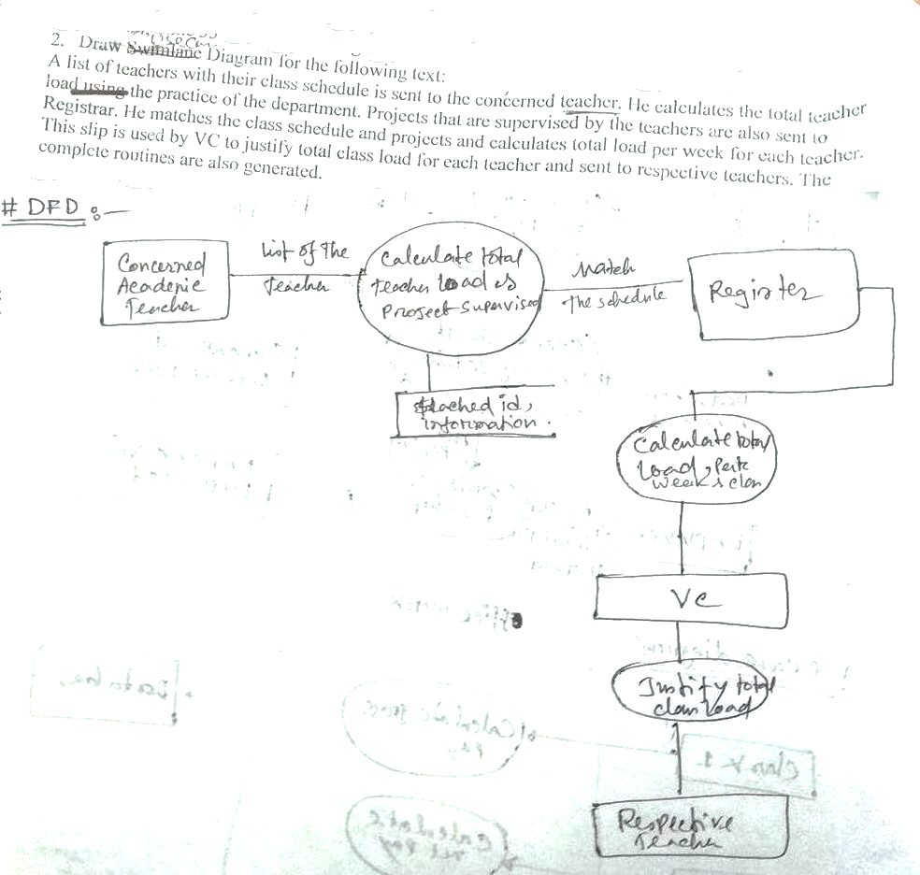
Example-4
A list of teachers with their class schedule is sent to the concerned teachers. He calculates the total teacher load using the practice of the department. Projects that are supervised by the teachers are also sent to Registrar. He matches the class schedule and projects and calculates total load per week for each teacher. This slip is used by the VC to justify total class load for each teacher and sent to the respective teachers. The complete routines are also generated.

Slide 46
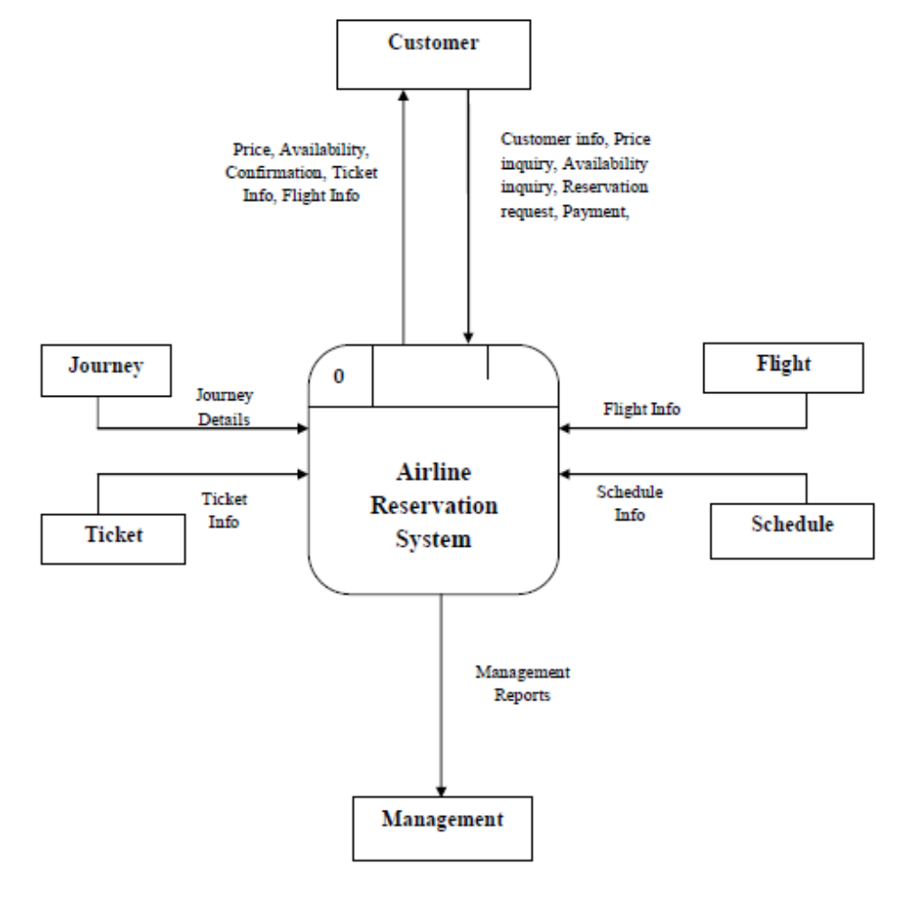
Example-5
Context Diagram for Airline Reservation System

Slide 47
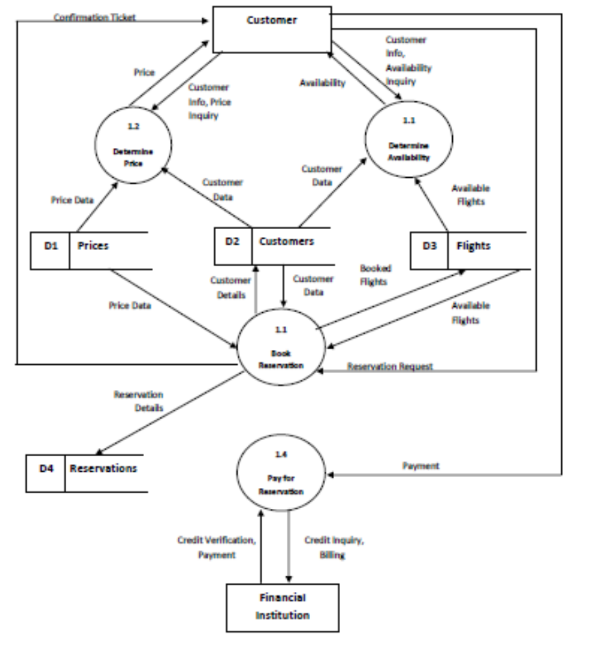
Level One Data Flow Diagram for Reservation Process

Slide 48
Other Approaches to RA
Prototyping
  Evolutionary
  Throw-away
Object Oriented
  Classes, attributes, methods
  Association between classes
  Class hierarchies
Requirements

Slide 49
Class diagram
  The purpose of class modeling is to describe objects.
  An object is a concept, abstraction or thing that has meaning for a domain/application.
  Some objects have real world counterparts while others are conceptual entities.
  The choice of objects depends on judgment and the nature of problem.
  ِAll objects have identity and are distinguishable.

Slide 50
Classes
  An object is an instance – occurrence – of a class
  ِ A class describes a group of objects with the same properties (attributes), behavior (operations), kinds of relationships, and semantics.
  The objects in a class share a common semantic purpose, above and beyond the requirement of common attributes and behavior.
  By grouping objects onto classes we abstract a problem.

Slide 51
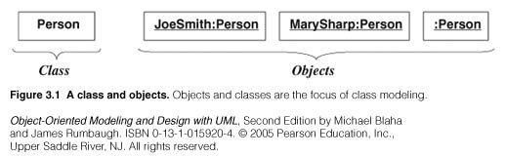
UML representation of classes/objects:
UML: Unified Modeling Language O.O Visual Modeling language
Class/object representation

Slide 52
Values and attributes
Value : piece of data.
Attribute: a named property of a class that describes a value held by each object of the class.
  Attributes may be discovered by looking for adjectives or by abstracting typical values.
  Don’t confuse values with objects:
    An attribute should describe values, not objects.
    Unlike objects, values lac identity

Slide 53
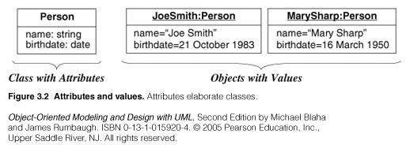
UML representation

Slide 54
Operations and Methods
An operation is a function or procedure that may be applied to or by objects in a class.
Each operation has a target object as an implicit parameter.
All objects in a class share the same operations.
The behavior of the operation depends on the class of its target.
The same operation may apply to many different classes. Such an operation is POLYMORPHIC.

Slide 55
Operations and Methods
A method is the implementation of an operation for a class.
A different piece of code may implement each method.
An operation may have arguments in addition to its target object. These arguments may be placeholders for values and/or for objects.
When an operation has methods on several classes these methods must have the same SIGNATURE: number and types of arguments, type of result value.

Slide 56
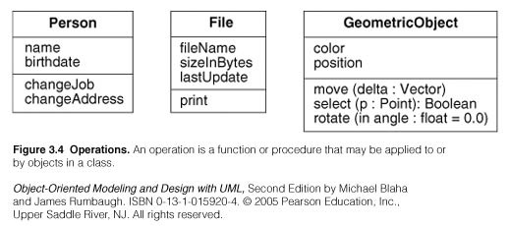
UML representation

Slide 57
Links and Association concepts
A link is a physical or conceptual connection among objects.
Most links relate two objects, but some links relate three or more objects.
A link is defined as a tuple, that is a list of objects.
A link is an instance of an association.
An association is a description of a group of links with common structure and semantics.
Association is denoted by a line. Its name is optional if the model is unambigious.

Slide 58
Class Diagram : Automobile
Automobile
public:
  seat
  seatBelt
  accelerator
private:
  sparkPlugs
  gear
protected:
  gloveCompartment
public:
  startEngine
  brake
protected: transmission
private: fuelInjection
B.Ramamurthy

Slide 59
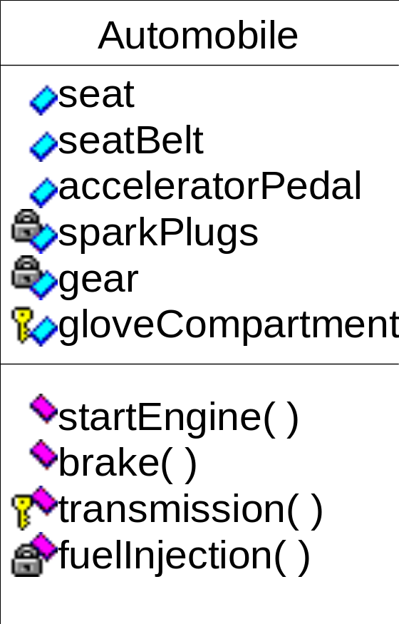
Automobile Class Using Rational Rose Tool
B.Ramamurthy

Slide 60
Access Control
Public, protected, private
Public properties and behaviors are available to any other object to use/invoke
Private: available only within the objects.
Protected: available within the objects and to the class hierarchy inherited from the class.
B.Ramamurthy

Slide 61
Relationships
Typically an application consists of many related classes.
Commonly used relationships include: associations, aggregations, and generalizations.
B.Ramamurthy

Slide 62
Association
An association is a connection between classes, a semantic connection between objects of classes involved in the association.
Association typically represents “has a” or “uses” relationships.
Indicated by a line,
  sometimes with arrow indicating unidirectional relationship,
  adorned by the name of the relation, and
  the ends of the line adorned by cardinality of relationship and optionally by the roles connected to each class.
B.Ramamurthy

Slide 63
Association : Examples
Uses
Person
Computer
A person uses a computer.
Owns
Person
0..*
Car
A person may own many (zero..many) cars.
B.Ramamurthy

Slide 64
Roles in Association
drives
Person
Car
driver
company car
A person (driver) drives a (company) car.
wife
Person
husband
married to
B.Ramamurthy

Slide 65
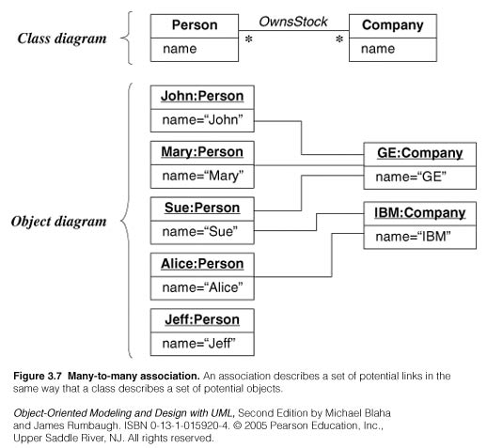
Examples

Slide 66
Associations are inherently bi-directional. The association name is usually read in a particular direction but the binary association may be traversed in either direction.
ِ A reference is an attribute in one object that refers to another object.

Slide 67
Multiplicity
It specifies the number of instances of one class that may relate to a single instance of the associated class.
UML diagrams explicitly list multiplicity at the end of association lines.
Intervals are used to express multiplicity:
  1 (exactly one)
  0..1 (zero or one)
  1..* (one or more)
  0..* (zero or more)
  3..5 (three to five inclusive)

Slide 68
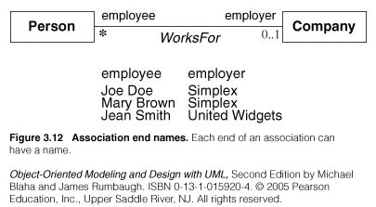
Association Ends
Associations have ends. They are called ‘Association Ends’.
They may have names (which often appear in problem descriptions).

Slide 69
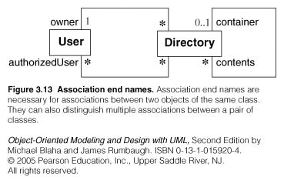
Association Ends
Use of association end names is optional.
But association end names are useful for traversing associations.
ِAssociation end names are necessary for for associations between objects of the same class.

Slide 70
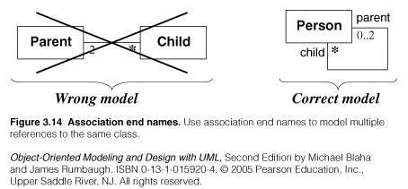
Example of association ends use

Slide 71
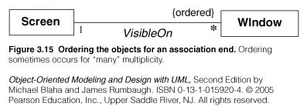
Association: ordering, bag, sequence
On a ‘many” association end, sometimes, it is required that objects have an explicit order.
In this case the ordering is an inherent part of the association
Example:

Slide 72
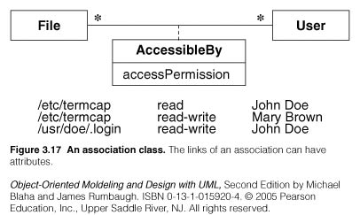
Association class
UML offers the ability to describe links of association with attributes like any class.
An association class is an association that is also a class.

Slide 73
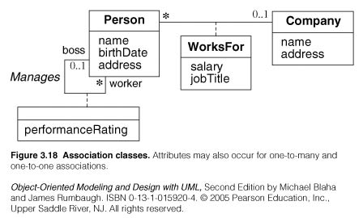
Association class
Examples:

Slide 74
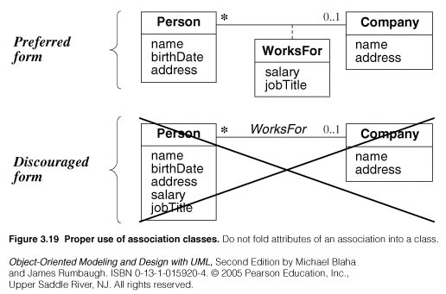
Association class
Example

Slide 75
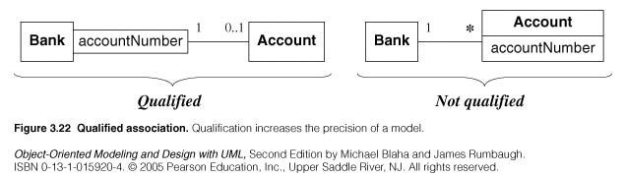
Qualified Association
A qualified association is an association in which an attribute called Qualifier disambiguates the objects for a ‘many’ association’ end.
A qualifier selects among the target objects, reducing the effective multiplicity fro ‘many’ to ‘one’.
Both below models are acceptable but the qualified model adds information.

Slide 76
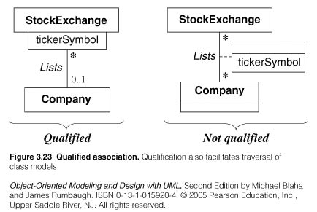
Qualified Association
Example:

Slide 77
Generalization/Inheritance
Generalization is the relationship between a class (superclass) and one or more variations of the class (subclasses).
Generalization organizes classes by their similarities and their differences, structuring the descriptions of objects.
A superclass holds common attributes, attributes and associations.
The subclasses adds specific attributes, operations, and associations. They inherit the features of their superclass.
Often Generalization is called a “IS A” relationship
Simple generalization organizes classes into a hierarchy.
A subclass may override a superclass feature (attribute default values, operation) by redefining a feature with the same name.
Never override the signature of methods.

Slide 78
Generalization
Generalization is a relationship between a general and a specific class.
The specific class called the subclass inherits from the general class, called the superclass.
Public and protected properties (attributes) and behaviors (operations) are inherited.
Design representation “inheritance” OO concept.
B.Ramamurthy

Slide 79
Generalization: Symbol
It represents “is a” relationship among classes and objects.
Represented by a line with an hollow arrow head pointing to the superclass at the superclass end.
B.Ramamurthy

Slide 80
Generalization: Example
Vehicle
Car
Boat
Truck
B.Ramamurthy

Slide 81
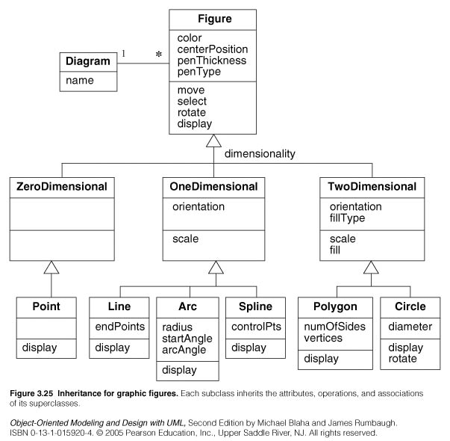

Slide 82
Use of generalization
Used for three purposes:
  Support of polymorphism:
    polymorphism increases the flexibility of software.
    Adding a new subclass and automatically inheriting superclass behavior.
  Structuring the description of objects:
    Forming a taxonomy (classification), organizing objects according to their similarities. It is much more profound than modeling each class individually and in isolation of other similar classes.
  Enabling code reuse:
    Reuse is more productive than repeatedly writing code from scratch.

Slide 83
Aggregation
Aggregation is a strong form of association in which an aggregate object is made of constituent parts.
The aggregate is semantically an extended object that is treated as a UNIT in many operations, although physically it is made of several lesser objects.
Aggregation is a transitive relation:
  if A is a part od B and B is a part of C then A is also a part of C
Aggregation is an antisymmetric relation:
  If A is a part of B then B is not a part of A.

Slide 84
Aggregation
Aggregation represents a relation “contains”, “is a part of”, “whole-part” relation.
Indicated by a line adorned on the “whole” by a hollow diamond
  Along with name of relationship and
  Cardinality.
B.Ramamurthy

Slide 85
Aggregation: Example
contains
League
Team
*
Membership aggregation: A league is made up of
Many teams.
4
wheel
made of
Auto
engine
Strong aggregation.
1
*
part
B.Ramamurthy

Slide 86
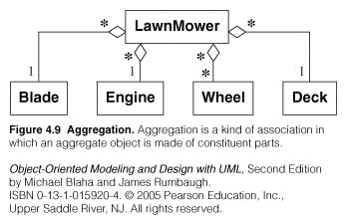

Slide 87
Aggregation versus Association
Aggregation is a special form of association, not an independent concept.
Aggregation adds semantic connotations:
  If two objects are tightly bound by a part-whole relation it is an aggregation.
  If the two objects are usually considered as independent, even though they may often be linked, it is an association. ِ
Discovering aggregation
  Would you use the phrase part of ?
  Do some operations on the whole automatically apply to its parts?
  Do some attributes values propagates from the whole to all or some parts?
  Is there an asymmetry to the association, where one class is subordinate to the other?

Slide 88
Aggregation versus Composition
Composition is a form of aggregation with additional constraints:
  A constituent part can belong to at most one assembly (whole).
    it has a coincident lifetime with the assembly.
    Deletion of an assembly object triggers automatically a deletion of all constituent objects via composition.
  Composition implies ownership of the parts by the whole.
    Parts cannot be shared by different wholes.

Slide 89
Aggregation versus Composition
Composition is a strong form of aggregation where:
    Deletion of a “whole” triggers automatically deletion of all its “parts”. (Lifetime)
“Parts” are included in at most one “whole” at a time. (Sharing)

Slide 90
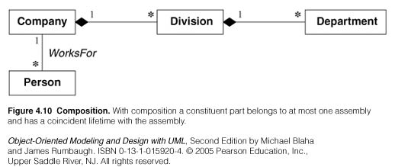

Slide 91
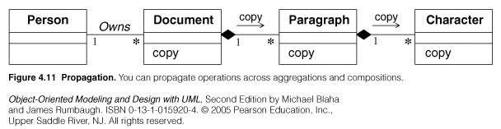
Propagation of operations
Propagation is the automatic application of an operation to a network of objects when the operation is applied to some starting object.
Propagation of operations to parts is often a good indicator of propagation.

Slide 92
Combined Example
drives
Person
0..*
Vehicle
Car
Boat
Truck
B.Ramamurthy

Slide 93
Requirements Specification
Analysis
Specification
Final output of requirements task is the SRS
Why are DFDs, OO models, etc not SRS ?
  SRS focuses on external behavior, while modeling focuses on problem structure
  UI etc. not modeled, but have to be in SRS
  Error handling, constraints etc. also needed in SRS
Transition from analysis to specification is not straight forward
Knowledge about the system acquired in analysis used in specification
Validation
Requirements

Slide 94
Characteristics of an SRS
Correct
Complete
Unambiguous
Consistent
Verifiable
Traceable
Modifiable
Ranked for importance and/or stability
Requirements

Slide 95
Characteristics…
Correctness
  Each requirement accurately represents some desired feature in the final system
Completeness
  All desired features/characteristics specified
  Hardest to satisfy
  Completeness and correctness strongly related
Unambiguous
  Each req has exactly one meaning
  Without this errors will creep in
  Important as natural languages often used
Requirements

Slide 96
Characteristics…
Verifiability
  There must exist a cost effective way of checking if sw satisfies requirements
Consistent
  two requirements don’t contradict each other
Traceable
  The origin of the req, and how the req relates to software elements can be determined
Ranked for importance/stability
  Needed for prioritizing in construction
  To reduce risks due to changing requirements
Requirements

Slide 97
Components of an SRS
What should an SRS contain ?
  Clarifying this will help ensure completeness
An SRS must specify requirements on
  Functionality
  Performance
  Design constraints
  External interfaces
Requirements

Slide 98
Functional Requirements
Heart of the SRS document; this forms the bulk of the specs
Specifies all the functionality that the system should support
Outputs for the given inputs and the relationship between them
All operations the system is to do
Must specify behavior for invalid inputs too
Requirements

Slide 99
Performance Requirements
All the performance constraints on the software system
Generally on response time , throughput etc => dynamic
Capacity requirements => static
Must be in measurable terms (verifiability)
  Eg resp time should be xx 90% of the time
Requirements

Slide 100
Design Constraints
Factors in the client environment that restrict the choices
Some such restrictions
  Standard compliance and compatibility with other systems
  Hardware Limitations
  Reliability, fault tolerance, backup req.
  Security
Requirements

Slide 101
External Interface
All interactions of the software with people, hardware, and sw
User interface most important
General requirements of “friendliness” should be avoided
These should also be verifiable
Requirements

Slide 102
Specification Language
Language should support desired charateristics of the SRS
Formal languages are precise and unambiguous but hard
Natural languages mostly used, with some structure for the document
Formal languages used for special features or in highly critical systems
Requirements

Slide 103
Structure of an SRS
Introduction
  Purpose , the basic objective of the system
  Scope of what the system is to do , not to do
  Overview
Overall description
  Product perspective
  Product functions
  User characteristics
  Assumptions
  Constraints
Requirements

Slide 104
Structure of an SRS…
Specific requirements
  External interfaces
  Functional requirements
  Performance requirements
  Design constraints
Acceptable criteria
  desirable to specify this up front.
This standardization of the SRS was done by IEEE.
Requirements

Slide 105
Requirements Validation
Analysis
Specification
Lot of room for misunderstanding
Errors possible
Expensive to fix req defects later
Must try to remove most errors in SRS
Most common errors
  Omission - 30%
  Inconsistency - 10-30%
  Incorrect fact - 10-30%
  Ambiguity - 5 -20%
Validation
Requirements

Slide 106
Requirements Review
SRS reviewed by a group of people
Group: author, client, user, dev team rep.
Must include client and a user
Process – standard inspection process
Effectiveness - can catch 40-80% of req. errors
Requirements

Slide 107
Summary
Having a good quality SRS is essential for Q&P
The req. phase has 3 major sub phases
  analysis , specification and validation
Analysis
  for problem understanding and modeling
  Methods used: SSAD, OOA , Prototyping
Key properties of an SRS: correctness, completeness, consistency, traceablity, unambiguousness
Requirements

Slide 108
Summary..
Specification
  must contain functionality, performance , interfaces and design constraints
  Mostly natural languages used
Validation - through reviews
Requirements

